Slide 1

Comparative Study of CNN Architectures for Ear Biometric-Based Person Identification
Submitted By:
Karan Veer Thakur (22054390)
Sanjana Thakur (22054393)
Aayush Bhandari (22054420)
Sambhavi Chaudhary (22054423)
Anand Jha Harsh (22054425)
Shubhankar Srivastava (22054429)
Submitted to
KIIT Deemed to be University,
Under the Guidance of
Dr. Partha Pratim Sarangi

Slide 2
ABSTRACT
Ear biometrics offers a stable, non-intrusive identification method, resistant to aging or expressions. This study evaluates five CNN architectures—EfficientNetB0, DenseNet121, MobileNetV2, VGG19, and ResNet50—using the AWE dataset (1,000+ ear images, 100 subjects). Preprocessed and augmented, the data was split (70% train, 20% test, 10% validation) and models fine-tuned via transfer learning. DenseNet121 and MobileNet achieved 100% accuracy, with EfficientNetB0 (99.42%), ResNet50 (99.20%), and VGG19 (98.86%) close behind. Results highlight CNN potential for biometric systems, with future scope in larger datasets, real-time use, and multi-modal integration.

Slide 3
OBJECTIVE
Goal:Evaluate five state-of-the-art CNNs for ear-based identification
Models:EfficientNetB0, DenseNet121, MobileNet, VGG19, ResNet50
Focus:Accuracy, efficiency, real-world applicability

Slide 4
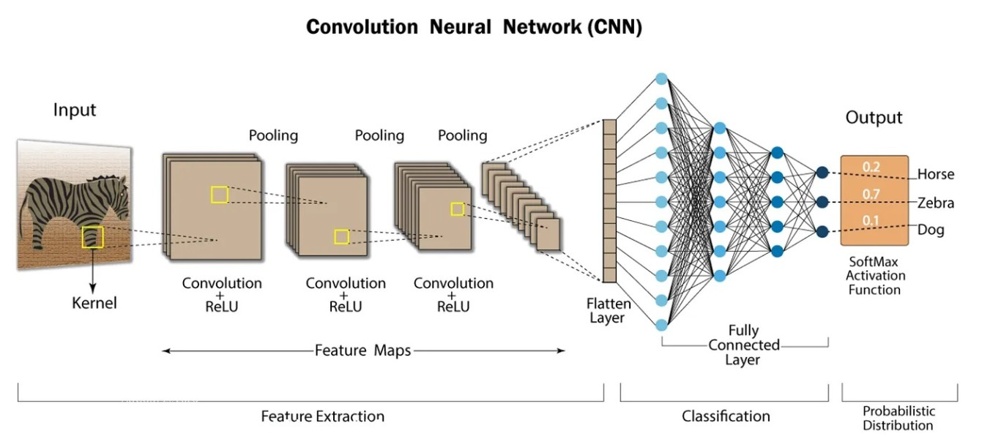
WHAT IS CNN?
CNN stands for Convolutional Neural Network, a type of neural network particularly effective for analyzing and processing visual data, like images, for tasks such as image recognition, object detection, and image classification.

Slide 5
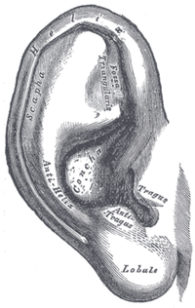
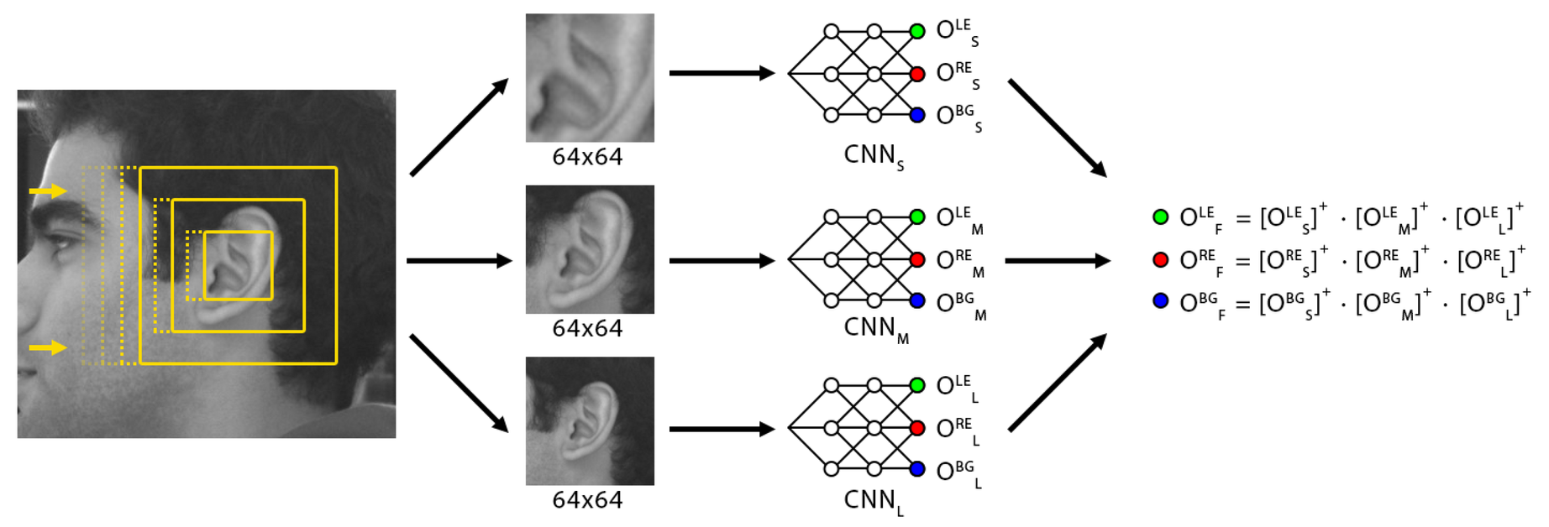
Why CNNs for Ears?
Extract Complex Patterns:
CNNs detect edges, textures, and shapes in ear images
Hierarchical feature learning captures intricate details
Ear-Specific Advantages:
Unique anatomical structure (e.g., helix, lobule)
Robust to lighting, pose variations with augmentation
Helix
Lobule

Slide 6
Dataset Architecture
AWEDataset
awe
Split_Data
train
001
001
002
002
003
test
003
006
003
004
003
val
006
004
045
005
005
066
045
066
005
003
005
006
100
100
045
066
005
Train - 70%
Test - 20%
Validation - 10%
Dataset Overview
Annotated Web Ears (AWE):1,000+ ear images, 100 subjects
Split:70% Training, 20% Testing, 10% Validation

Slide 7
Choosen CNN Models
EfficientNetB0: Optimizes accuracy and efficiency using a compound scaling method; has about 5.3 million parameters.
DenseNet121: Features dense connectivity for improved accuracy and feature reuse; has around 8 million parameters.
MobileNet: Lightweight model for mobile and edge devices using depthwise separable convolutions; has approximately 4.2 million parameters.
VGG19: Deep CNN with 19 layers using small 3x3 filters for high accuracy; contains about 143 million parameters.
ResNet50: Utilizes residual learning with skip connections to train very deep networks; consists of around 25.6 million parameters.

Slide 8
Methodology Overview
Transfer Learning:
Instead of training a model from scratch, we leverage the knowledge gained by a pre-trained model (trained on a large dataset like ImageNet) and adapt it to the specific task of ear recognition.
Key Steps:
Preprocessing:
Image Resizing: Ensure all images are of a consistent size.
Normalization: Scale pixel values to a specific range (e.g., 0-1).
Data Cleaning: Remove any noisy or irrelevant data.
Augmentation:
Random Rotations: Rotate images by a small angle.
Random Flipping: Flip images horizontally or vertically.
Zooming: Zoom in or out slightly.
Brightness Adjustment: Adjust the brightness of images.
These augmentations help the model generalize better to variations in the input data .
Fine-Tuning for ear recognition:
We further train the pre-trained model on a dataset of ear images, adjusting its parameters to improve performance on the target task.
Training:
Model Selection: Choose a suitable pre-trained model (e.g., MobileNetV2, VGG16).
Layer Freezing/Unfreezing: Decide which layers of the pre-trained model to freeze (keep their weights fixed) and which to fine-tune.
Training Loop: Feed the preprocessed and augmented data to the model, adjust the weights of the fine-tuned layers, and evaluate the model's performance on a validation set.
Evaluation:
Metrics: Use appropriate metrics to evaluate the model's performance, such as accuracy, precision, recall, and F1-score.
Validation Set: Evaluate the model's performance on a separate validation set to assess its generalization ability.
Testing Set: Evaluate the model's performance on a separate test set to get an unbiased estimate of its performance.

Slide 9
Data Augmentation
Techniques:
Rotation (±30°): Rotates images randomly up to 30 degrees clockwise or counterclockwise to simulate varied orientations.
Zoom (±20%): Randomly zooms in or out by up to 20%, altering the scale of objects in the image.
Flipping: Horizontally or vertically flips images to introduce mirror-like variations.
Brightness: Adjusts the brightness level (e.g., darker or lighter) to mimic different lighting conditions.
Goal:
Enhance Variability: Increases the diversity of the training dataset by generating new, realistic image variations.
Prevent Overfitting: Helps the model generalize better by reducing reliance on specific patterns in the original data, improving robustness to unseen examples.

Slide 10

Implementing Process
Environment Setup
Data Preparation
Model Construction
Installed TensorFlow and imported libraries like NumPy, Keras, and Matplotlib to create a functional AI development environment.
Mounted Google Drive, changed to the “awe” dataset directory, and listed image files to prepare for model processing.
Loaded pre-trained MobileNetV2, froze its layers, and added custom layers (Pooling, Dense, Dropout) for a 10-class classification task.
Model Loading and Re-evaluation
Initial Prediction Attempt
Model Compilation
Configured the model with SGD optimizer, categorical crossentropy loss, and accuracy metric for training and evaluation.
Configured the model with SGD optimizer, categorical crossentropy loss, and accuracy metric for training and evaluation.
Reviewing AI performance and making necessary adjuMade predictions with the untrained model on test_ds, resulting in all outputs as 0 due to lack of training.
stments
Output Analysis
Potential Next Steps
Reviewed the prediction outputs (e.g., 0, 714, 906) to assess the model’s performance and identify potential improvements.
Considered retraining or fine-tuning the model with additional data to enhance accuracy and adapt to new categories.

Slide 11
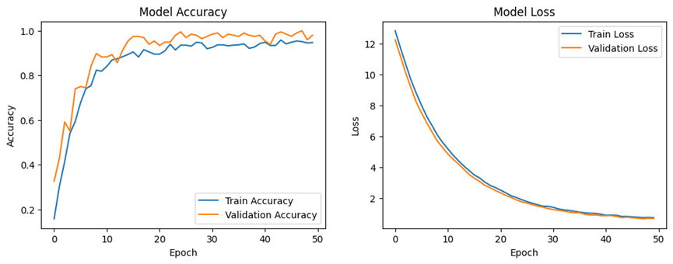
EfficientNetB0
Epoch: 50 x 22
Training- 70%
Testing- 20%
Validation - 10%
Training Generator with Augmentation:
Rotation Range: 30°
Width Shift Range: 0.2 (20%)
Height Shift Range: 0.2 (20%)
Shear Range: 0.2 (20%)
Zoom Range: 0.2 (20%)
Horizontal Flip: Enabled
Create Data Flow for Training, Testing, and Validation:
Target Size: 224x224
Batch Size: 32
Class Mode: Categorical
Model Compilation:
Optimizer: SGD (Learning Rate: 0.01,
Momentum: 0.9)
Loss: Categorical Crossentropy
Metrics: Accuracy
Output Layer Definition:
Dense Units: 10
Activation: ReLu
Accuracy - 100%
Loss: 0.7296

Slide 12
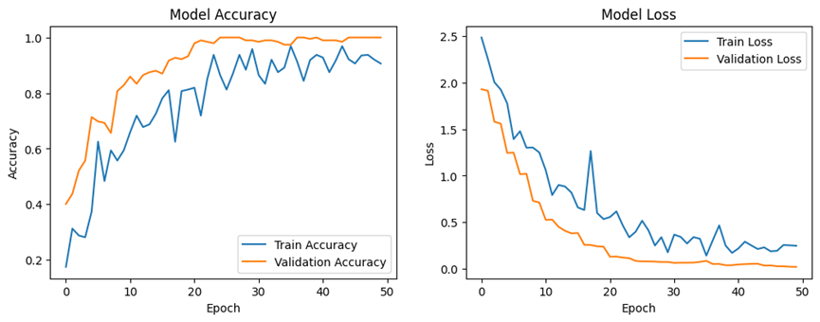
DenseNet121
Epoch: 50 x 22
Training- 70%
Testing- 20%
Validation - 10%
Training Generator with Augmentation:
Preprocessing: EfficientNet preprocess_input
Rotation Range: 30°
Width Shift Range: 0.2 (20%)
Height Shift Range: 0.2 (20%)
Shear Range: 0.2 (20%)
Zoom Range: 0.2 (20%)
Horizontal Flip: Enabled
Create Data Flow for Training:
Target Size: 224x224
Batch Size: 32
Class Mode: Categorical
Model Architecture:
Global Average Pooling: Applied
Dense Layer 1: 512 units, ReLU activation
Dropout 1: 0.5 (50%)
Dense Layer 2: 256 units, ReLU activation
Dropout 2: 0.5 (50%)
Output Layer: 10 units, Softmax activation
Model Definition: Inputs from base_model, Outputs as predictions
Accuracy-100%
Loss: 0.1418

Slide 13
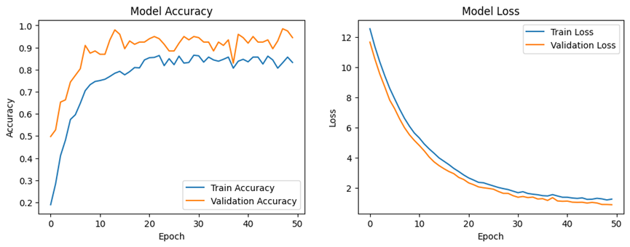
MobileNetV2
Epoch: 50 x 22
Training- 70%
Testing- 20%
Validation - 10%
Training Generator with Augmentation:
Preprocessing: EfficientNet preprocess_input
Rotation Range: 30°
Width Shift Range: 0.2 (20%)
Height Shift Range: 0.2 (20%)
Shear Range: 0.2 (20%)
Zoom Range: 0.2 (20%)
Horizontal Flip: Enabled
Create Data Flow for Training:
Target Size: 224x224
Batch Size: 32
Class Mode: Categorical
Model Compilation:
Optimizer: SGD (Stochastic Gradient Descent)
Learning Rate: 0.01
Momentum: 0.9
Loss: Categorical Crossentropy
Metrics: Accuracy
Accuracy: 98.49%
Loss: 1.2749

Slide 14
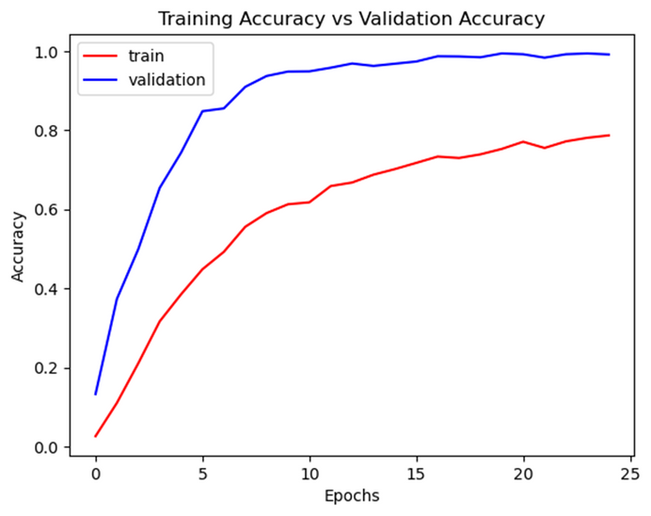
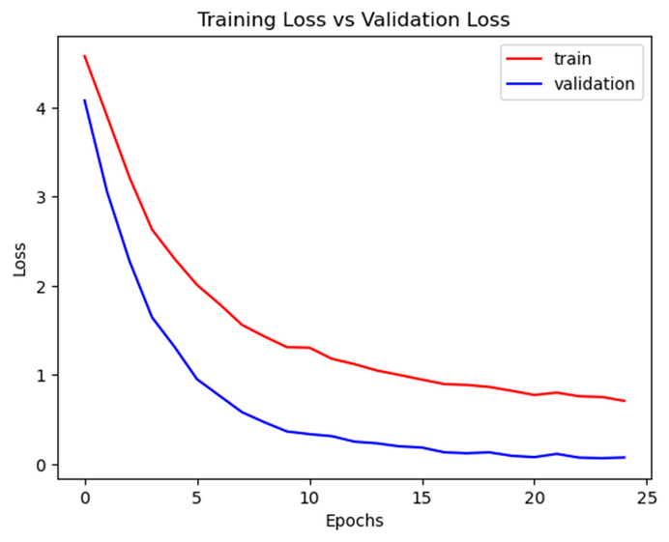
ResNet50
Epoch: 50 x 218
Training- 70%
Testing- 20%
Validation - 10%
ImageDataGenerator:
Rotation Range: 3°
Horizontal Flip: Enabled
Fill Mode: Nearest
Directory: Train, Test, Validation
Target Size: 224x224
Batch Size: 32
ResNet50 Model:
Weights: ImageNet pre-trained
Input Shape: 224x224x3 (RGB)
Model Architecture:
Input: ResNet50 output
Global Average Pooling: Applied
Dense Layer 1: 512 units, ReLU activation
Dropout 1: 0.5 (50%)
Dense Layer 2: 256 units, ReLU activation
Dropout 2: 0.5 (50%)
Output Layer: 100 units, Softmax activation
learning rate = 0.001
Accuracy 99.39%
Loss: 0.7091

Slide 15
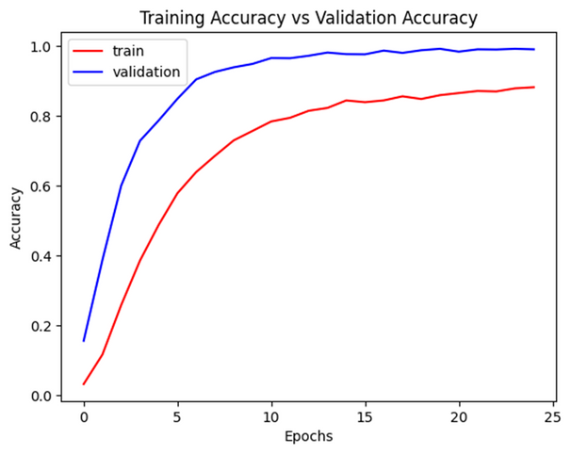
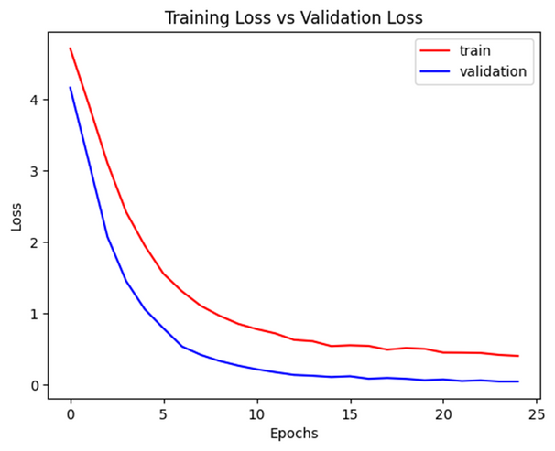
VGG19
Epoch: 25 x 218
Training- 70%
Testing- 20%
Validation - 10%
Model Architecture:
Input: VGG19 output
Global Average Pooling: Applied
Dense Layer 1: 512 units, ReLU activation
Dropout 1: 0.5 (50%)
Dense Layer 2: 256 units, ReLU activation
Dropout 2: 0.5 (50%)
Output Layer: 100 units, Softmax activation
ImageDataGenerator:
Rotation Range: 3°
Horizontal Flip: Enabled
Fill Mode: Nearest
VGG19 Model:
Include Top: False (excludes top classification layer)
Weights: ImageNet pre-trained
Input Shape: 224x224x3 (RGB)
Model Compilation:
Optimizer: Adam
Learning Rate: 0.001
Loss: Categorical Crossentropy
Metrics: Accuracy
Accuracy: 99.24%
Loss: 0.4048

Slide 16
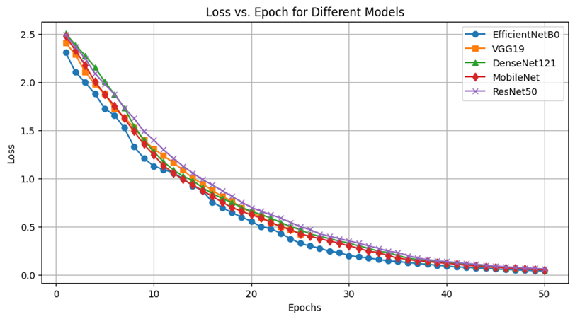
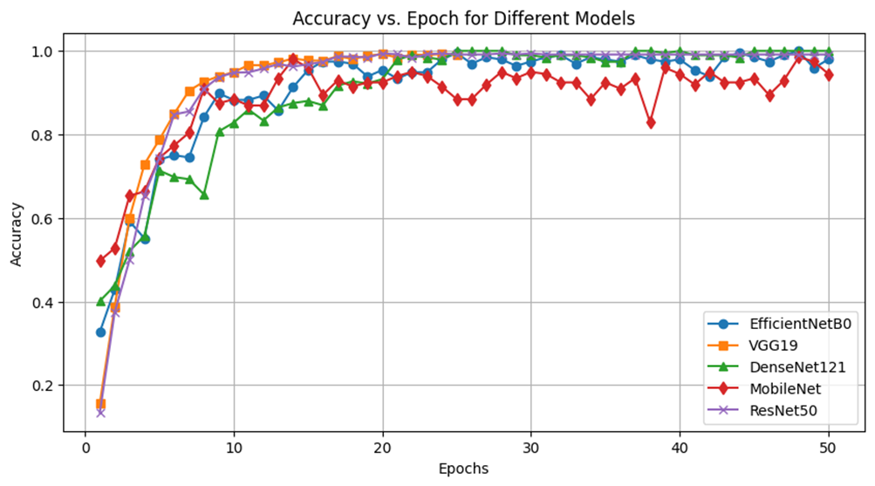
Results - Accuracy & Loss Comparison
Model Best Accuracy Loss
EfficientNetB0 100.00% 0.7296
DenseNet121 100.00% 0.1418
ResNet50 99.39% 0.7091
VGG19 99.24% 0.4048
MobileNet 98.49% 1.2749

Slide 17
Conclusion
EfficientNetB0 and DenseNet121 are the top-performing models, reaching 100% accuracy.
ResNet50 and VGG19 follow closely with 99%+ accuracy.
MobileNet has the lowest accuracy but still performs well at 98.49%.

Slide 18
Thank You
Acknowledgment: Dr. Partha Pratim Sarangi

